Slide 1


Querying the Data Lake
with Athena and Quicksight

Slide 2


Anti-Pattern
Everything
Query
RDBMS

Slide 3
Also an Anti-Pattern
Everything
Query
RDBMS
Data Lake

Slide 4












One tool to rule them all

Slide 5





























Session’s Focus
Amazon Amazon Elasticsearch AWS
AWS
AppSync
Amazon API Gateway
Amazon Cognito
DynamoDB Service
Glue
Access & User Interfaces
Catalog & Search
Central Storage
Scalable, secure, cost- effective
Amazon Athena
Amazon EMR
AWS
Glue
Amazon Redshift
Amazon DynamoDB
AWS
Snowball
Amazon Kinesis Data Firehose
AWS Direct Connect
S3
AWS Database AWS Storage Migration Gateway Service
Manage & Secure
Amazon Elasticsearch Service
Amazon QuickSight
Amazon Kinesis
Amazon Neptune
Amazon RDS
AWS
DataSync
AWS Transfer for SFTP
Amazon S3 Transfer Acceleration
Analytics & Serving
AWS KMS
AWS IAM
AWS
CloudTrail
Amazon CloudWatch
Data Ingestion

Slide 6
Session’s Focus
Amazon Amazon Elasticsearch AWS
AWS
AppSync
Amazon API Gateway
Amazon Cognito
DynamoDB Service
Glue
Access & User Interfaces
Catalog & Search
Central Storage
Scalable, secure, cost- effective
Amazon Athena
Amazon EMR
AWS
Glue
Amazon Redshift
Amazon DynamoDB
AWS
Snowball
Amazon Kinesis Data Firehose
AWS Direct Connect
S3
AWS Database AWS Storage Migration Gateway Service
Manage & Secure
Amazon Elasticsearch Service
Amazon QuickSight
Amazon Kinesis
Amazon Neptune
Amazon RDS
AWS
DataSync
AWS Transfer for SFTP
Amazon S3 Transfer Acceleration
Analytics & Serving
AWS KMS
AWS IAM
AWS
CloudTrail
Amazon CloudWatch
Data Ingestion

Slide 7


Amazon Athena
Interactive query service to analyze data in Amazon S3 using standard SQL
No infrastructure to set up or manage and no data to load Ability to run SQL queries on data archived in Amazon Glacier
Query Instantly Pay per query Open Easy
SQL
Zero setup cost; just point to S3 and start querying
Pay only for queries run; save 30–90% on per- query costs through compression
ANSI SQL interface, JDBC/ODBC drivers, multiple formats, compression types, and complex joins and data types
Serverless: zero infrastructure, zero administration
Integrated with QuickSight

Slide 8

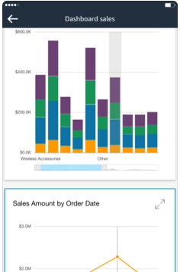
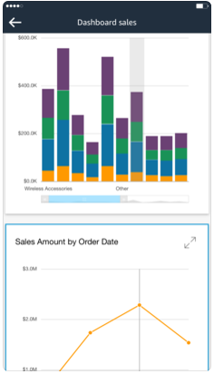
Amazon QuickSight
BI service with pay-per-session pricing for everyone in your organization
Serverless, cloud powered BI service (no servers to manage) Scale from 10s of users to 100s of thousands of users
Fast, interactive visualizations powered by SPICE Integrates with S3, Athena, Redshift, RDS, Aurora & EMR Pay only for what you use
Readers: $0.30/30 min session with a $5/user/month max
Authors: $18/month/Author

Slide 9

Start Querying Instantly
Serverless
No clusters
No data warehouses
No ETL
Get started instantly
Point to data in S3
Define your schema
Start querying

Slide 10

Pay Per Query
Pay only for queries you run
Query directly from S3
No additional storage charge
Save costs and improve performance
Compression
Partitioning
Columnar formats

Slide 11

Runs standard SQL
Uses Presto with ANSI SQL support
Works with standard data formats
CSV
Apache Weblogs
JSON
Parquet
ORC
Handles complex queries
Large Joins
Window functions
Arrays

Slide 12
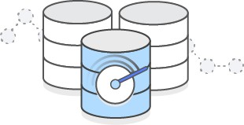
Fast Performance for Large Data Sets
Fast, ad-hoc queries
Executes queries in parallel
No provisioning extra resources for complex queries
Scales automatically
Amazon Athena Federated Query (Preview)

Slide 13
When to use Athena vs EMR
Athena
Ad-hoc querying
Serverless
No setup or management of cluster
Run queries using standard SQL
Scales automatically based on complexity of queries
EMR
Data processing/ETL
Build and manage your own cluster
Run custom applications and code
Use big data processing frameworks
Spark, Hadoop, Presto, or HBase

Slide 14
When to use Athena vs Redshift
Athena
Ad-hoc querying
Serverless
No setup or management of cluster
Run queries using standard SQL
Scales automatically based on complexity of queries
Redshift
Data warehouse
Historical analysis and reporting
Need to setup a cluster
Run queries against highly structured data with many joins
Can use same S3 data source as Athena

Slide 15
Create External Tables
Use Apache Hive DDL to create table
Run DDL statements using the Athena console
Via a JDBC driver, using SQL workbench
Using the Athena create table wizard
Create “external” table in DDL
Creates a view of the data
Deleting table doesn’t delete the data in S3
Schema-on-read
Projects your schema onto data at query execution time
No need for data loading or transformation

Slide 16
Partitions
Partition on any column in table
Limits the amount of data each query scans
Common practice
Multi-level time based partition
Example
PARTITIONED BY (year STRING, month STRING, day STRING)
Performance and cost savings on queries filtering by day, month and year

Slide 17
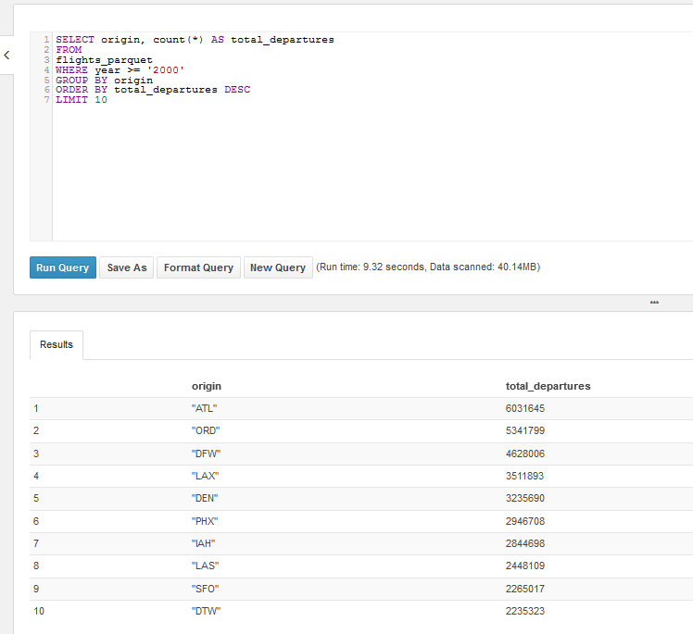
How does partitioning work?
Flight dataset in Parquet
Partitioned by year
Group by query
Top 10 airports with the most departures since 2000
Where year >= 2000
Athena doesn’t have to scan data in partitions before year 2000
Amount of data scanned affects pricing
1 min 6s, 3.11GB for unpartitioned
37.37 s, 2.25GB for CSV
9.32 secs, 0.04GB for Parquet

Slide 18

Access Control for Athena
Access Control
AWS Identity and Access Management (IAM)
Access Control Lists (ACLs)
Amazon S3 bucket policies.
IAM policies for S3
IAM is natively integrated with S3
Grant IAM users fine-grained control to S3
Restrict users from querying it using Athena

Slide 19
Access Control Continued
To run queries in Athena, you must have the appropriate permissions for the following:
Athena API actions including additional actions for Athena workgroups
Amazon S3 locations where the underlying data to query is stored.
Metadata and resources that you store in the AWS Glue Data Catalog, such as databases and tables, including additional actions for encrypted metadata.

Slide 20
Best Practices
Partition your data
Divides your table into parts and keeps the related data together based on column values such as date, country, region, etc
Compress and split files
Can speed up your queries significantly
Optimize File Sizes
Ensuring that your file formats are splittable helps with parallelism

Slide 21
Best Practices Continued
Optimize columnar data store generation
Apache Parquet and Apache ORC
Optimize Queries
ORDER BY
JOIN
GROUP BY
LIKE
Only include the columns that you need

Slide 22
Workgroups
Separate users, teams, applications, or workloads
In order to:
Cost controls by setting limits on the amount of data each query or the entire workgroup can process
Track costs

Slide 23
Setting Up Workgroups
Decide which workgroups to create. For example, you can decide the following:
Who can run queries in each workgroup, and who owns workgroup configuration. This determines IAM policies you create.
Create workgroups as needed, and add tags to them.
Open the Athena console, choose
the Workgroup:<workgroup_name> tab, and then choose Create workgroup.
Create IAM policies for your users, groups, or roles to enable their access to workgroups.
Specify a location in Amazon S3 for query results and encryption settings

Slide 24
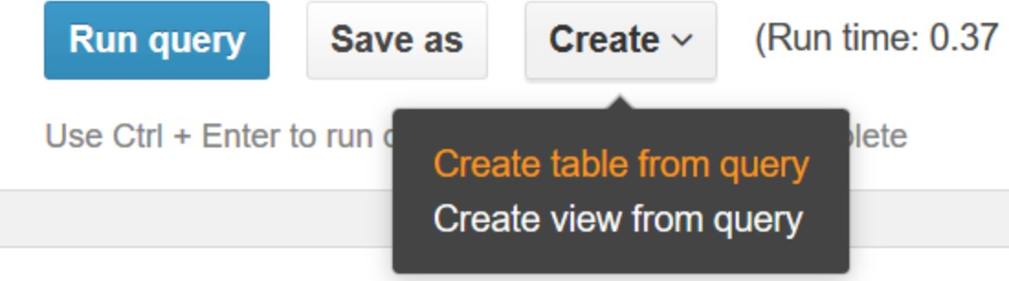
CREATE TABLE AS SELECT (CTAS)
Creates a new table in Athena from the results of a SELECT statement from another query
Athena stores data files created by the CTAS statement in a specified location in Amazon S3

Slide 25
Use CTAS queries to:
Create tables from query results in one step, without repeatedly querying raw data sets. This makes it easier to work with raw data sets.
Transform query results into other storage formats, such as Parquet and ORC. This improves query performance and reduces query costs in Athena.
Create copies of existing tables that contain only the data you need.

Slide 26
Monitoring Athena Queries with CloudWatch Metrics
Use CloudWatch Events with Athena:
EngineExecutionTime – in milliseconds
ProcessedBytes – the total amount of data scanned per DML query
QueryPlanningTime – in milliseconds
QueryQueueTime – in milliseconds
ServiceProcessingTime – in milliseconds
TotalExecutionTime – in milliseconds, for DDL and DML queries

Slide 27
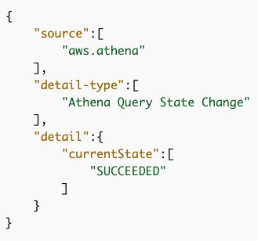
Monitoring Athena Queries with CloudWatch Events
Use simple rules to match events and route them to one or more target functions or streams.
Respond to operational changes and takes corrective action as necessary, by
Sending messages to respond to the environment
Activating functions
Making changes
Capturing state information

Slide 28

Key Benefits of Athena
Fast ad-hoc queries
Query directly against data in S3
Use standard ANSI SQL
No infrastructure to setup and manage
Use IAM for security
JDBC driver for BI tools and SQL clients
Pay per query, depending on data scanned

Slide 29




Dashboards - Near Real-time
Visual Representation of key metrics that change over time
Data structure - Low
Usage - Near real-time visualization
Data temperature - Hot
Not a use case for Athena & Quicksight
Available Services:
AWS Lambda
Amazon DynamoDB
Amazon Kinesis Data Streams
Amazon Elasticsearch Service

Slide 30










Dashboards + Search
ETL
OR
AWS Glue
Amazon EMR
Data Lake
Dynamo Streams
AWS
Lambda
Amazon Elasticsearch
DynamoDB
Raw Bucket
Transformed Data Bucket
Users
Amazon Kinesis Firehose
Amazon S3

Slide 31




Ad Hoc Analysis
Information sought on an as-needed basis
Usage - Dynamic Data Querying
Data structure - Case based
Data temperature - Medium - cold
Available Services:
Amazon ElasticSearch
Amazon Redshift Spectrum
Amazon Athena
Amazon EMR

Slide 32



Reports
Static representations of data rendered at a point in time
Usage - Point in time data extraction
Data structure - High
Data temperature – Medium - cold
Available Services:
Amazon Redshift
Amazon Athena
Amazon QuickSight

Slide 33



























Ad-Hoc Analysis and Reports
ETL
OR
Amazon Redshift
AWS Glue
Amazon EMR
Data Lake
Raw Bucket
Transformed Data Bucket
Amazon Redshift Spectrum
OR
Amazon S3
Amazon Athena
Amazon QuickSight

Slide 34




Ad-Hoc Analysis and Reports – Lab scenario
AWS Glue Data Catalogue
Amazon S3
Amazon Athena
Amazon QuickSight

Slide 35
Ad-Hoc Analysis and Reports – Lab scenario – prep 1
Athena Hive DDL
AWS Glue Data Catalogue
Amazon S3
Amazon Athena

Slide 36
Ad-Hoc Analysis and Reports – Lab scenario – prep 2
AWS Glue Data Catalogue
Dimensions tables
Amazon S3
Amazon Athena

Slide 37

Ad-Hoc Analysis and Reports – Lab scenario - explore
AWS Glue Data Catalogue
select
join
Amazon S3
Amazon Athena

Slide 38
Ad-Hoc Analysis and Reports – Lab scenario - visualize
AWS Glue Data Catalogue
dashboards
Amazon S3
Amazon Athena
Amazon QuickSight

Slide 39











Additional cases: SaaS
AWS Glue Data Catalog
Hot data
S3
Application request
Warm & cold data
Query data
Athena

Slide 40











Additional cases: ETL and query use-case
Athena CTAS and INSERT INTO to ETL
Glue Data Catalog
Update table partition
AWS service logs
S3
S3
Query data
Application logs
Data sourced from external vendors
Raw Data
Transformed data
Athena

Slide 41



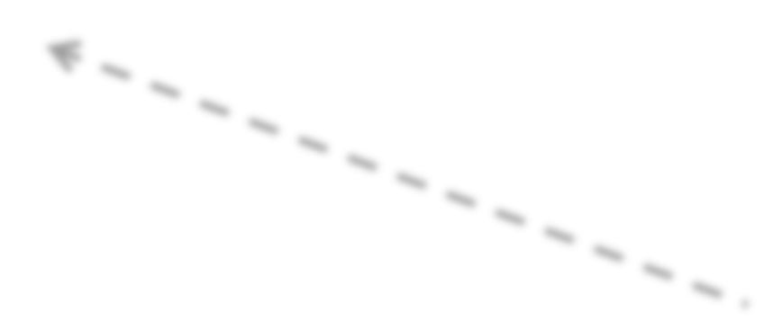





Additional cases: Data science and feature engineering
Glue Data Catalog
S3
Transformed data
Query data
S3
Athena
SageMaker
Raw Data

Slide 42
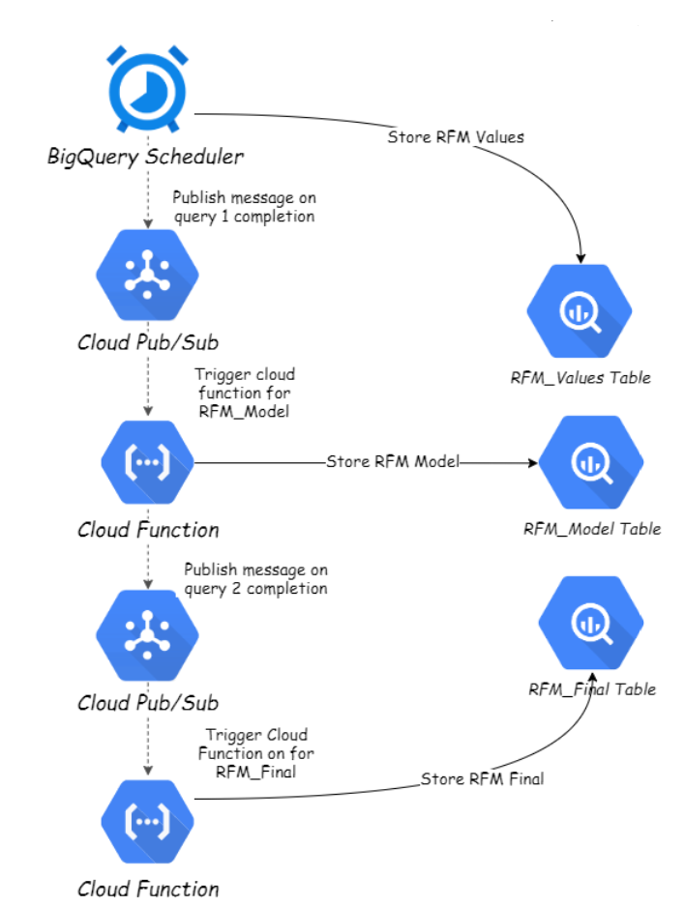

Slide 43

Thank you!

